Slide 1

3. Business Strategies and Their Marketing Implications
Corporate
SBUs
How to compete
Market
New Products
Allocate resources and efforts for SBUs sake
Profile
6 Major Sectors
Strategy
Alliances to expand
New products in current and new markets
SBUs
Drug sector spend more on R&D and ads
60,000 products
Tapes sector to maintain leadership and gain more profits, more sales force and less ads
Strategy fit

Slide 2
3.1 Strategic Decisions at the Business-Unit Level
Corporate Level
Mission
Objective
SBU Level
Scope
SBU Objectives
Marketing Level
Competition Plan
Resources Deployment

Slide 3
3.1.1 How Should Strategic Business Units Be Designed?
Homogenous Markets & Limited techs
NO 2 SBUs compete on same customers with same products
Authority over success factors
Responsible for profitability
Ideal
Practical
Technical compatibility
Same customer needs
Same customer behaviour

Slide 4
3.1.2 Business-Unit Objectives
SBUs/ Products Sub-objectives
Stable
High profitability
High ROI
New
High share
ROI is not the important now

Slide 5
3.1.3 Allocating Resources within the Business Unit
Resources between markets??
Portfolio
Value-based planning
Use activity-based costing system
Shared investment

Slide 6
3.2 How Do Businesses Compete?
Competitive Advantage
SBU core competencies and resources
Customers characteristics
Industry Characteristics

Slide 7
3.2.1 Generic Business-Level Competitive Strategies
Cost
(Effective Operation)
Differentiation
Design, service
Focus
(little piece)

Slide 8
3.2.1 Generic Business-Level Competitive Strategies
Prospector
Focus on growth through the development of new products and markets
Defender
Maintaining their positions in established product-markets
Analyzer
Attempts to maintain a strong position in its core product-market(s)
Also seeks to expand into new– usually closely related – product-markets
Reactor
No clearly define strategy.

Slide 9
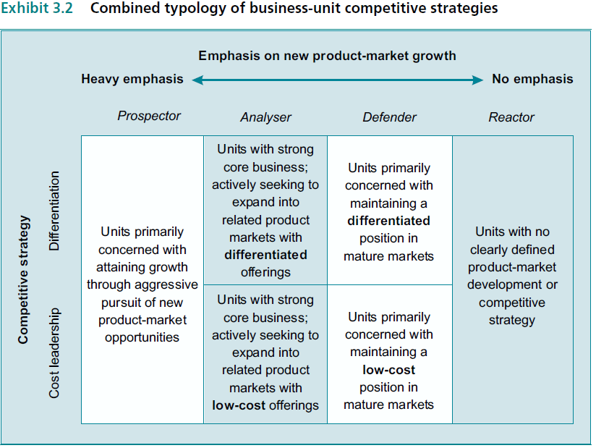
3.2.1 Generic Business-Level Competitive Strategies

Slide 10
3.2.2 Do the Same Competitive Strategies Work for Single-Business Firms and Start-ups?
Yes
Same set of generic competitive strategies is just as appropriate for small firms as for business units within larger ones
BUT there are differences
Marketing and business strategies blur and comes as one
By definition start-ups do not have an established market position to defend, they begin as prospectors

Slide 11
3.2.3 Do the Same Competitive Strategies Work for Service Businesses?
Yes
AMEX tailored to specific segments of the firm’s credit-card holders
Others focus narrowly on defending established positions in current markets
Cable &Wireless is considered as differentiated analyzer.

Slide 12
3.2.4 Do the Same Competitive Strategies Work for Global Competitors?
Analyser
Defend in home and foreign well-established markets and prospect in new markets
This suggests that a single SBU may need to engage in different functional activities
Adopt different organisational structures to implement those activities
Huawei works as defender in China and prospector outside

Slide 13
3.2.5 Will the Internet Change Everything?
Yes
Price differentiations , but is not the only thing
Innovation will increase at prime prices
Excellent communication tool for segments
Personalization and customization, such as logistical alliances among organisational buyers and their suppliers
Price
Innovation
Communication
Personalization

Slide 14
3.3 How Do Competitive Strategies Differ from One another?
Scope
Competitive
Resources
Synergy
Objectives

Slide 15
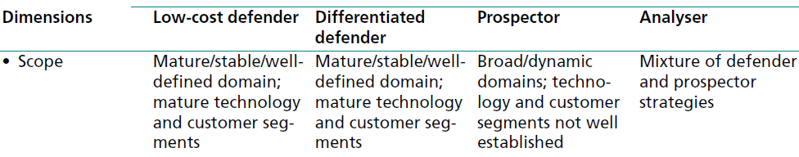
3.3.1 Differences in Scope
Prospector
Wide range
Defender
Narrow
Analyser
In Between

Slide 16
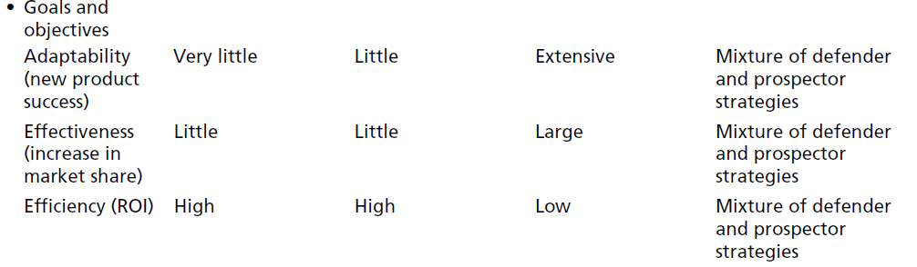
3.3.2 Differences in Goals and Objectives
Effectiveness
Sales Growth
Efficiency
Profitability & ROI
Adaptability
New successful products

Slide 17
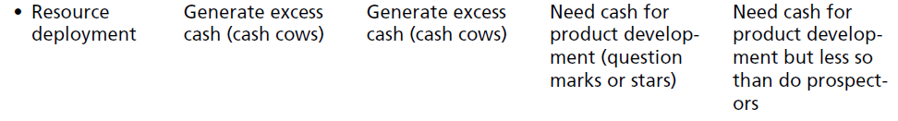
3.3.3 Differences in Resource Deployment

Slide 18
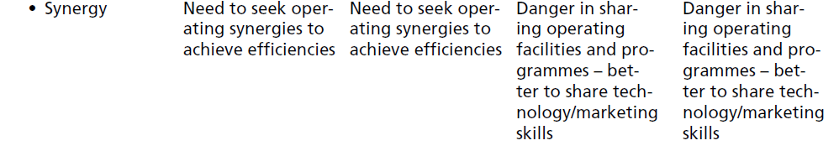
3.3.4 Differences in Sources of Synergy

Slide 19
3.4 Deciding When a Strategy Is Appropriate: The Fit between Business Strategies and the Environment
 | Prospector | Analyser | Low cost Defender | Differentiated Defender
Market | Newborn | Some still | Mature or decline | Mature or decline
Tech. | Undeveloped | Basic Developed | Fully developed | Fully developed
Business Relative Strengths | Strong R&D | Good R&D but not the best | Process engineering and quality control and/or in marketing, sales, distribution or customer services. | Sources supply and process engineering to make lower cost than competitors
Competition | Few | Many but shaky | Few well established ones | Few well established ones

Slide 20
3.4.1 Appropriate Conditions for a Prospector Strategy
Market
New products and or/ shifting customer needs
Relative Strengths
R&D
Marketing Research
Competition
Few competitors
Technology
New on, with many undeveloped applications

Slide 21
3.4.2 Appropriate Conditions for an Analyser Strategy
Market
Late growth or early maturity
Relative Strengths
R&D but as good as main competitors
Marketing Research
Competition
Many competitors with shaky future
Technology
Basic existing technologies
One segment are not approached yet
New Products at the same time
One or more competitors hold large portion

Slide 22
3.4.3 Appropriate Conditions for a Defender Strategy
It is most appropriate for units with a profitable share of one or more major segments in a relatively mature, stable industry
Initiate process improvements, product improvements, or line extensions to help protect and strengthen their established positions
Works best in industries where the basic technology is not very complex

Slide 23
3.4.3.1 Differentiated Defenders
Market
Maturity or decline stage
Relative Strengths
Competition
Few well established competitors
Technology
Basic technology fully developed and stable; few major modifications or improvements likely
Superior product quality >> production, process engineering, quality control and perhaps product engineering and marketing to develop product improvements
Possibility of acquisition

Slide 24
3.4.3.2 Low-Cost Defenders
Market
Maturity or decline stage
Relative Strengths
Competition
Few well established competitors
Technology
Basic technology fully developed and stable; few major modifications or improvements likely
Low cost production >> superior sources of supply, R&D, process engineering, product engineering, sales effort. Mass production … etc.
Possibility of acquisition

Slide 25
3.5 How Different Business Strategies Influence Marketing Decisions
Marketing manager monitors and evaluates the product’s environmental situation and develops a marketing program suited to it.
Business unit’s competitive strategy might be a constrain
SBU’s strategy influences the amount of resources committed to marketing
And influences kind of market and competitive situations
NO 100% mapping between SBU strategy and marketing components picked, but still some generic observations could be noticed

Slide 26
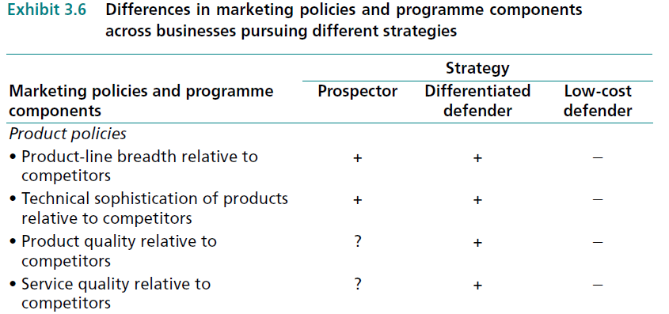
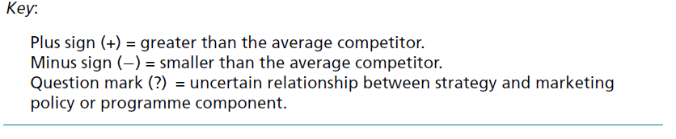
3.5.1 Product Policies
Define quality

Slide 27
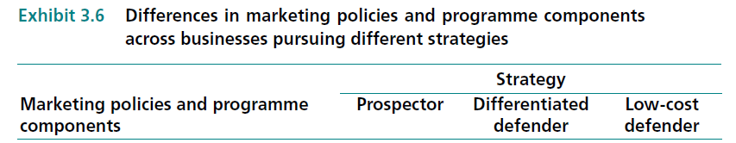
3.5.2 Pricing Policies

Slide 28
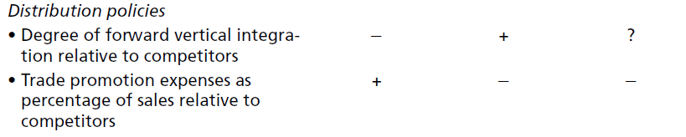
3.5.3 Distribution Policies
Case by case

Slide 29
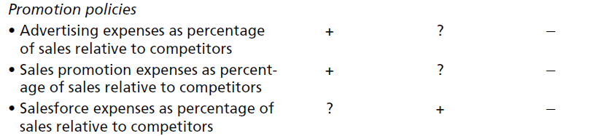
3.5.4 Promotion Policies

Slide 30
3.6 What If the Best Marketing Programme for a Product Does Not Fit the Business’s Competitive Strategy?
Defender
Low R&D budget
Limited products
Analyser
Intermediate stage
Prospector
Eventually
Might cause cultural shocks
Prospector
Prospector
Defender
Old Org
New Org
Marketing manager is responsible for pointing out any mismatches between what is best for the product and the capabilities of the organisational unit to which it belongs

